Slide 1
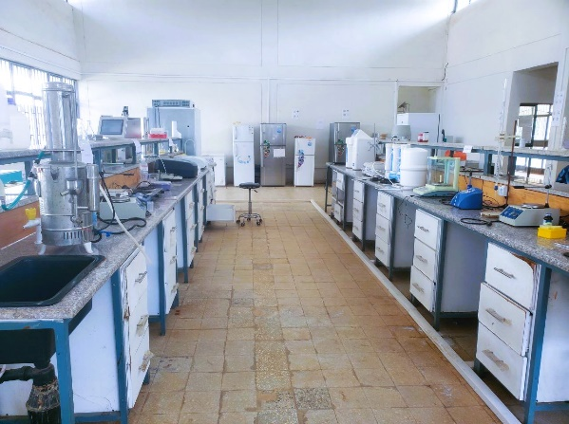
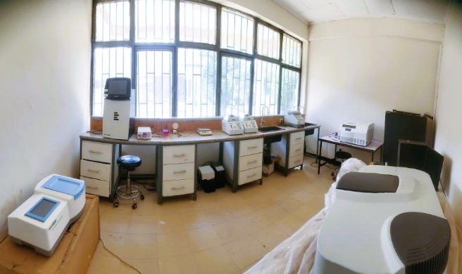
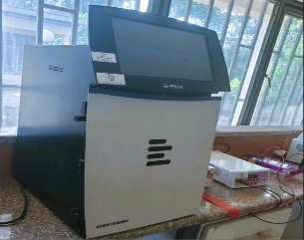
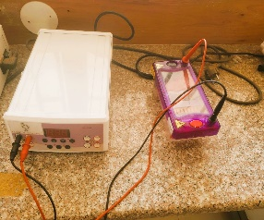
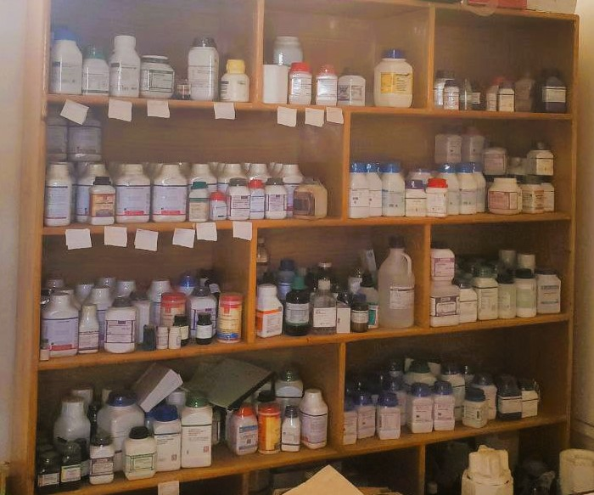
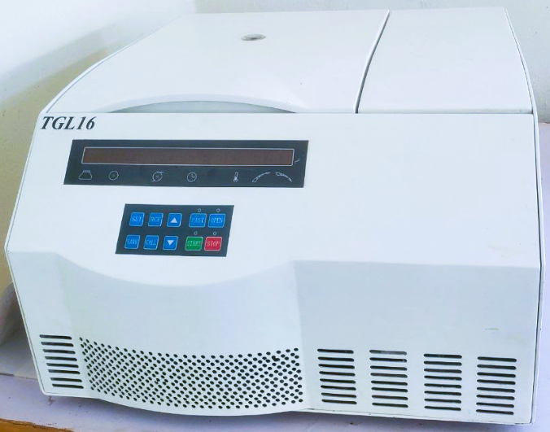
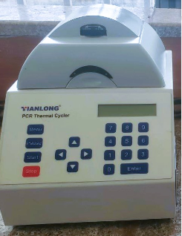
Institute of Biotechnology Laboratories
Laboratories play a crucial role in assuring quality education by providing hands-on learning experiences that reinforce theoretical knowledge. Institute of Biotechnology has well-organized laboratories to ensure relevance support of researcher and students in execution of high-quality research and development activities, fostering innovation, and enabling practical application of scientific principles through precise experimentation and analysis
Contact person:
Dagnew Bitew (PhD)
Laboratory Manager
Email: btdagne@gmail.com
Inst. Email: Dagnew.Bitew@bdu.edu.et
Cell phone: +251920227460
Laboratories
Molecular Biology
Microbiology
Instrumental
Bioinformatics
Plant tissue culture
Laboratory Facilities
Molecular Biology Laboratory
DNA and RNA extraction
DNA quality measurement (Spectroscopy and electrophoresis)
PCR amplification
Protein SDS page Separation
Molecular Biology Lab
General Lab Setup
Gel Documentation System
Consumables Store
Ultra-centrifuge
PCR

Slide 2
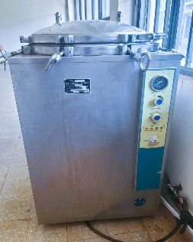
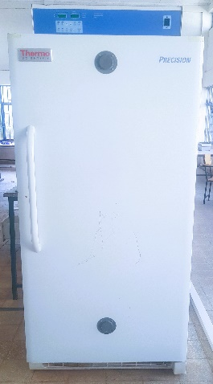
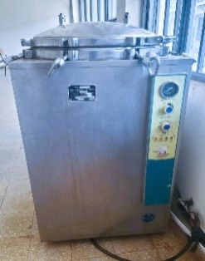
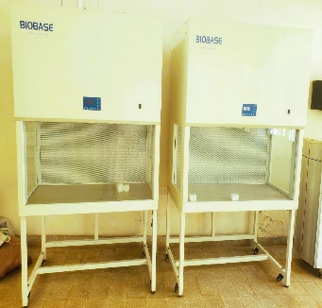
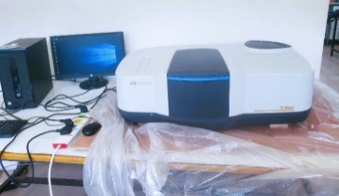
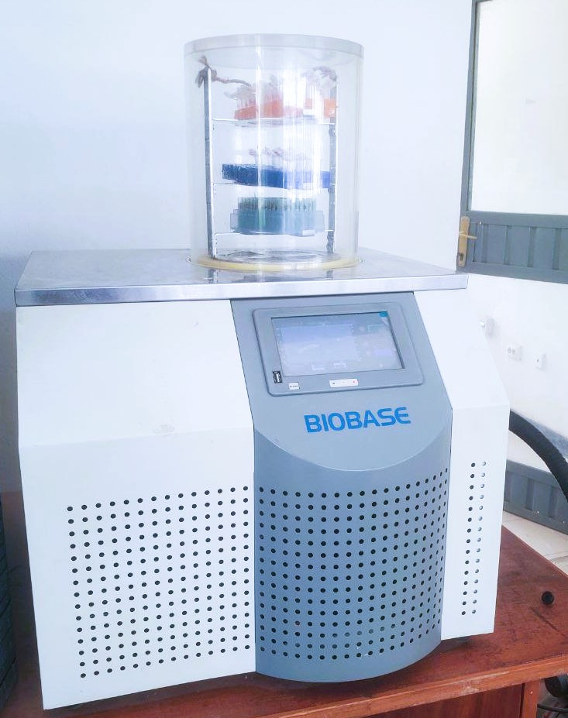
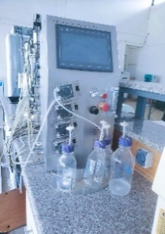
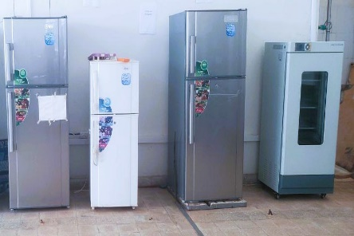
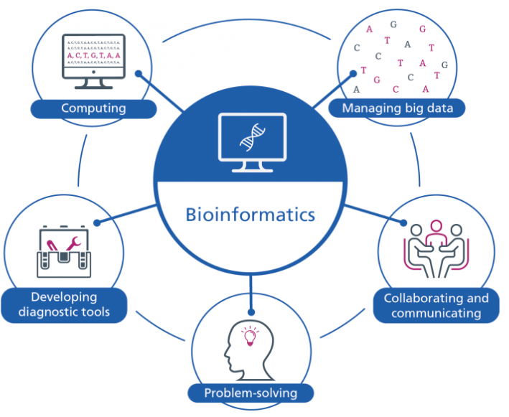
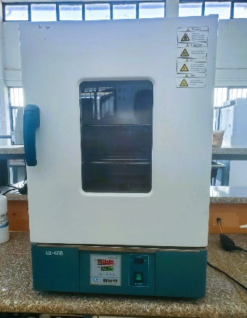
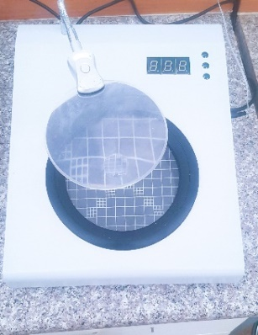
Microbiology Laboratories
All classical microbiology activities
Fermentation
Inoculum development
Strain improvement
Microbial molecular identification
Microbial transformation
Food safety and quality analysis
Instrumental Laboratory
Heavy metal analysis
Nutrient analysis
Protein and DNA determination
Extraction of essential oils and bioactive compounds
Ecotoxicology analysis of toxic chemicals (Pesticides and herbicide)
Pollutant identification and determination
Plant Tissue Culture Laboratory
Micro propagation of horticultural crops, medicinal and spice plants (Herbs)
Cryopreservation germplasm resources
Extraction and production of plant secondary metabolites
UV-Spectrophotometer
Autoclave
Laminar Air flow
Autoclave
Growth Chamber
Bioinformatics Laboratory
Bioreactor
Refrigerators
Incubator
Colony counter
Lyophilizer

